Slide 1
CS 4530
Software Engineering
Lecture 8 - Testing
Jonathan Bell, John Boyland, Mitch Wand
Khoury College of Computer Sciences

Slide 2
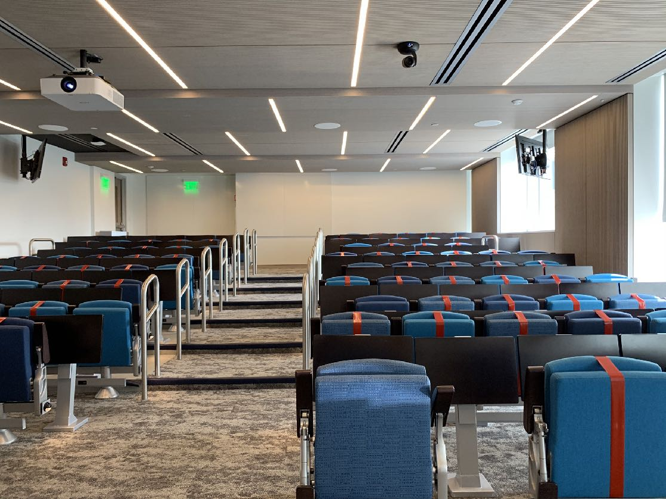
Zoom Mechanics
Recording: This meeting is being recorded
If you feel comfortable having your camera on, please do so! If not: a photo?
I can see the zoom chat while lecturing, slack while you’re in breakout rooms
If you have a question or comment, please either:
“Raise hand” - I will call on you
Write “Q: <my question>” in chat - I will answer your question, and might mention your name and ask you a follow-up to make sure your question is addressed
Write “SQ: <my question>” in chat - I will answer your question, and not mention your name or expect you to respond verbally

Slide 3
Today’s Agenda
Administrative:
HW2 due tomorrow
HW3, Project pitch posted tomorrow
Today’s session:
Review: Testing
Activity: Testing the Transcript Server

Slide 4

Dijkstra’s Law
Pioneer of Software Engineering as a discipline
“Program testing can be used to show the presence of bugs, but never to show their absence”
Notes:
Static vs dynamic: note that

Slide 5
Testing: Two Key Challenges
What inputs should I test?
For those scenarios: what outputs should I check?

Slide 6

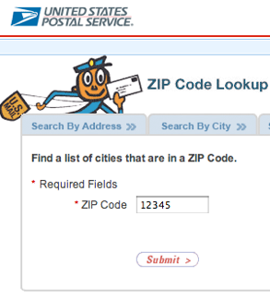
Example: ZIP Code
What inputs should I test?
Input: 5-digit ZIP code
Output: list of cities
What are representative values to test?
(from Pezze + Young, “Software Testing and Analysis”, Chapter 10)
Notes:
As an example to illustrate Functional Testing, let’s consider an application that looks up the cities that are within a given ZIP code.
<…>

Slide 7
Valid ZIP Codes
What inputs should I test?
with 0 cities as output (0 is boundary value)
with 1 city as output
with many cities as output
Notes:
To test valid zip codes, you pick valid inputs that have 5 digits and for which there are
0 cities as output
1 city as output
many cities as output

Slide 8
Invalid ZIP Codes
What inputs should I test?
empty input
1–4 characters (4 is boundary value)
6 characters (6 is boundary value)
very long input
no digits
non-character data
Notes:
We should also try to create tests that try using invalid ZIP codes
For example, we could create a test that uses an empty input
or given that the expected input is 5 digits, we can try inputs that are too short, or too long, or that contain non-numeric data
Note - testing all zip codes would be hard (especially zip+4!)

Slide 9
What inputs should I test?
Two high level answers
“Black box” input generation: consider specification, conduct boundary value analysis
“White box” input generation: look at code, figure out input values that will exercise all branches in code

Slide 10
Automated Tests
Is this an effective test?
describe('Create student', () => {
it('should return an ID', async () => {
const createdStudent = await client.addStudent('Avery');
expect(createdStudent.studentID).toBeGreaterThan(4);
});
})
Notes:
Here’s an example of a test written in TypeScript from the transcript server. What is up with this test? [Well, it’s self-documenting]. What does this test check for? Anything? [Minor point: if client.addStudent threw error, we’d fail the test]

Slide 11
Automated Tests
Tests are only as good as their inputs and their assertions!
describe('Create student', () => {
it('should return an ID', async () => {
const createdStudent = await client.addStudent('Avery');
expect(createdStudent.studentID).toBeGreaterThan(4);
});
})
Test Oracle
Notes:
What this test was missing is an assertion. The assertion specifies what is called a “test oracle” - a way to determine if the test passed or not. It is easy: that there is a student ID.
But how do the testers know in advance what the expected output should be?
Or, alternatively, how can testers write assertions to check that the actual output is correct for the given input?
Customer requirements, such as user stories, may not specify exactly how to determine the correct output for every possible input, and may not even define was “correctness” means

Slide 12
Possible Test Oracles
What output should we expect for a given input?
Human tester infers the right answer
Simply not crashing is “right”
Formal specification prescribes the right answer
Notes:
Human tester “knows”
Naive - if it doesn’t crash, hang, or produce obviously nonsensical output, it works!
Formal specification - mandatory for safety-critical systems, rare for business/consumer applications
Wait until users complain that the software didn’t do what they expected, then write test cases to check for what they say they expected 😁
Pseudo-oracles m​ ay be available in some cases, where one test case acts as an oracle for another test case

Slide 13
Pseudo-Oracles
What if we don’t know what the output should be?
Regression testing: expect same results on new versions of code
Differential testing: compare multiple implementations
Notes:
Regression testing is the most common form of pseudo-oracle, where we repeat test cases with known results on old version to see if they have the same or different results on new version.
Some of those test cases ​should​ change results, e.g., when we fix a bug that caused a test case to fail, we expect it to pass. But unrelated test cases should not - if they do, that indicates a new bug.
“Differential testing” is another kind of pseudo-orcale, which requires a second independently developed implementation of the same functionality
➢If they disagree, one or both is wrong
➢If they agree, does that mean both are right?

Slide 14
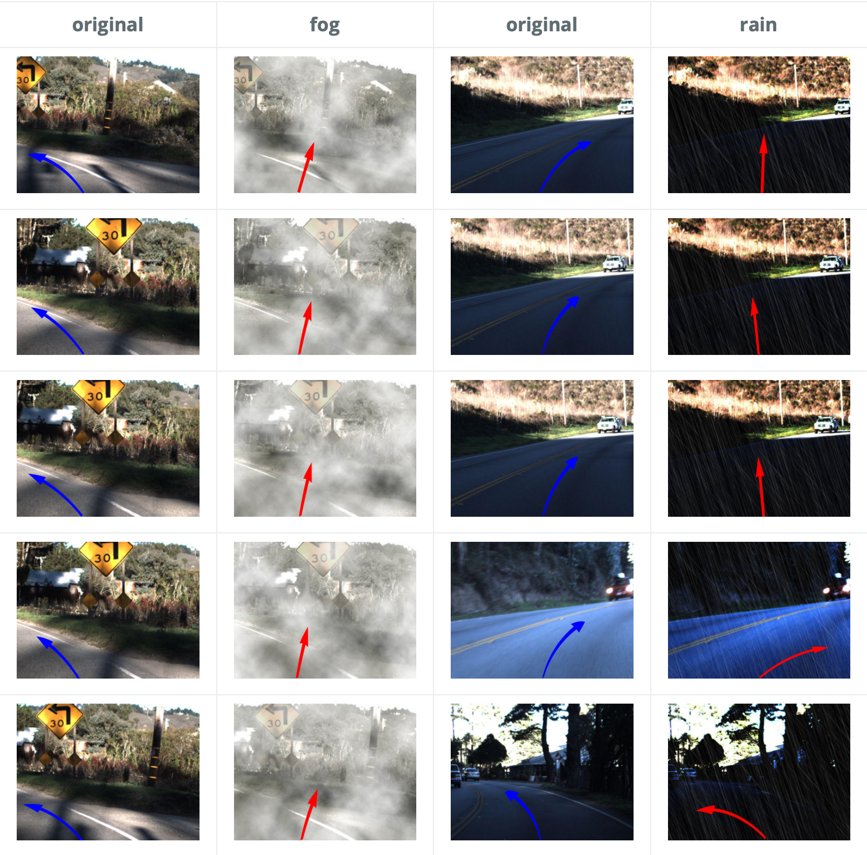
Pseudo-Oracles and Machine Learning
Testing self-driving cars
Problem: ML application learns from traffic images, determines how to steer car safely
How do we exhaustively generate inputs?
Approach: apply image transformations to known cases
“DeepTest: Automated Testing of Deep-Neural-Network-driven Autonomous Cars,” Tian et al, ICSE 2018
Notes:
Say we have a machine learning application that is supposed to learn from series of traffic images how to control the steering of a self-driving car, so it obeys traffic laws and doesn’t cause accidents.
How do we know what is “correct” steering for a given real-world driving scenario? How would we write test cases?

Slide 15
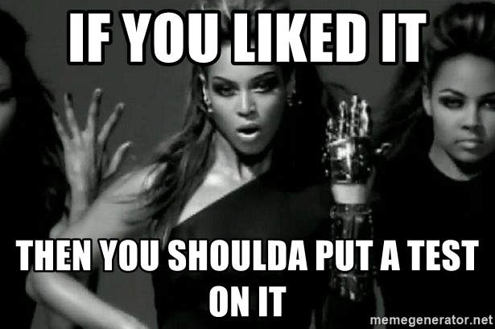
What makes a good test?
The Beyoncé Rule
“Software Engineering at Google: Lessons Learned from Programming Over Time,” Wright, Winters and Manshreck, 2020 (O’Reilly)
Notes:
The Beyoncé Rule is often invoked by infrastructure teams that are responsible for making changes across the entire codebase. If unrelated infrastructure changes pass all of your tests but still break your team’s product, you are on the hook for fixing it and adding the additional tests.
SO MUCH more great stuff in this book

Slide 16





What makes a good test?
The Beyoncé Rule, applied
{
Test A
Test B
Test
“Test is OK!”
Makes changes to code
Runs Tests
Developer
Test B
“Test failed!”
Notes:
Beyoncé Rule in practice: a developer makes some change to code, then runs the tests, then regardless of the outcome (pass or fail) dev is still happy. If no tests fail, you trust that you didn’t break anything: since anything important should have a test written to make sure that it doesn’t break. If any test fails, you are still happy, because you found that you broke it RIGHT AWAY, can fix it, and in the best case, nobody else even needs to find out that you broke this!

Slide 17
What makes a good test?
More than just coverage and oracles
Tests should be hermetic: reduce flakiness
Tests should be clear: improves debugging later on
Tests should be scoped as small as possible: faster and more reliable
Tests should make calls against public APIs
“Software Engineering at Google: Lessons Learned from Programming Over Time,” Wright, Winters and Manshreck, 2020 (O’Reilly)
Notes:
All tests should strive to be hermetic: a test should contain all of the information necessary to set up, execute, and tear down its environment. Tests should assume as little as possible about the outside environment, such as the order in which the tests are run. For example, they should not rely on a shared database. This constraint becomes more challenging with larger tests, but effort should still be made to ensure isolation.
Keeping tests clear and simple aids reviewers in verifying that the code does what it says it does. Clear code also aids in diagnosing failure when they fail. We like to say that “a test should be obvious upon inspection.”
Unit tests form an excellent base because they are fast, stable, and dramatically narrow the scope and reduce the cognitive load required to identify all the possible behaviors a class or function has. Additionally, they make failure diagnosis quick and painless.
write tests that invoke the system being tested in the same way its users would; that is, make calls against its public API rather than its implementation details. If tests work the same way as the system’s users, by definition, change that breaks a test might also break a user. As an additional bonus, such tests can serve as useful examples and documentation for users.

Slide 18
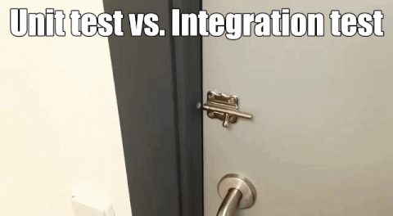
Integration Tests
Notes:
Motivation: Units that worked in isolate may not work in combination
Performed after all units to be integrated have passed all unit tests
Reuse unit test cases that cross unit boundaries (that previously required stub(s) and/or driver standing in for another unit)

Slide 19
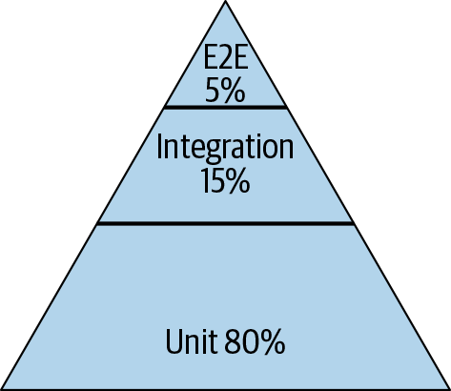
Integration Tests
Individual unit correctness does not imply full system correctness
Google’s Ideal Software Testing Pyramid
Software Testing Anti-Pattern: Ice Cream Cone Testing
Figures: “Software Engineering at Google: Lessons Learned from Programming Over Time,” Wright, Winters and Manshreck, 2020 (O’Reilly)
Notes:
Unit tests form an excellent base because they are fast, stable, and dramatically narrow the scope and reduce the cognitive load required to identify all the possible behaviors a class or function has. Additionally, they make failure diagnosis quick and painless.
Ice cream cones are delicious, but not a good look for testing. This pattern might best describe why developers hate testing: if a test has a smaller scope (like a unit test), then it will be easier to write, easier to read, and most importantly, easier to debug. The ice cream cone is full of rich, GUI tests where a lot of huge tests test large swaths of program behavior. This is not a good pattern. Focus on unit tests, then build up integration tests as needed, and then even larger end-to-end system level integration tests.

Slide 20
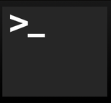
Integration vs Unit Testing
Well, how do you define “unit”?
Integration
Unit
Mork
1 class of one program running on a web server
1 process running on a web server
Notes:
So, focus on unit tests. What do integration tests include? Well, we started out by saying that a unit test focuses a single module or class. So, if we’re testing an entire application, then that surely is an integration test. If we are working at any reasonable scale, it’s likely that we will want to write tests for things bigger than a single application that is just one process running on one server.

Slide 21

Integration vs Unit Testing
Well, how do you define “unit”?
Integration
Unit
Mork
1 class of one program running on a web server
1 web server in a cluster of 100,000
1 process running on a web server
Notes:
For instance, our idea of our server software might actually consist of multiple processes running in coordination on a single server, which itself might be in a cluster of 100’s of thousands of servers.

Slide 22
Integration vs Unit Testing
Well, how do you define “unit”?
Integration
Unit
Mork
1 class of one program running on a web server
1 Google product in the entire Google ecosystem
1 web server in a cluster of 100,000
1 process running on a web server
Notes:
Or, maybe our focus is on testing the end-to-end behavior of an entire product, which is composed of many classes running in many processes on many servers. As you can see, the scope of integration tests can grow enormously.

Slide 23
Integration vs Unit Testing
Consider not just scope, but size
“Large”
Integration
Unit
“Medium”
“Small”
Mork
1 class of one program running on a web server
1 Google product in the entire Google ecosystem
1 web server in a cluster of 100,000
1 process running on a web server
“Software Engineering at Google: Lessons Learned from Programming Over Time,” Wright, Winters and Manshreck, 2020 (O’Reilly)
Notes:
Google: classify every our tests into a size and encourage engineers to always write the smallest possible test for a given piece of functionality. Test size is what it is allowed to do, and how many resources it consumes. small tests run in a single process, medium tests run on a single machine, and large tests run wherever they want. Small tests, regardless of the scope, are almost always faster and more reliable than tests that involve more infrastructure or consume more resources. More can go wrong if you have to spin up entire VMs in the middle of your test.

Slide 24
How big is my test?
Considerations for test code at Google
Small: run in a single thread, can’t sleep, perform I/O or making blocking calls
Medium: run on single computer, can use processes/threads, perform I/O, but only contact localhost
Large: Everything else
“Software Engineering at Google: Lessons Learned from Programming Over Time,” Wright, Winters and Manshreck, 2020 (O’Reilly)
Notes:
Small tests are structured to be fastest, most reliable. This becomes important if you want to run your tests a lot, like if you have ten thousand developers running tests 24/7. Similar to traditional unit/
Medium can do lots of stuff, but note importance of not connecting to other servers. This is so your entire test is self contained.
Large is everything else. These can be slowest to run and most fragile. Imagine you are testing connecting to a remote server, and sometimes it’s slow, or the canonical distributed systems example of an intern tripping over a cable. So, speaking of fragile.

Slide 25
What makes a good test?
More than just coverage and oracles
Tests should be hermetic: reduce flakiness
Tests should be clear: improves debugging later on
Tests should be scoped as small as possible: faster and more reliable
Tests should make calls against public APIs
“Software Engineering at Google: Lessons Learned from Programming Over Time,” Wright, Winters and Manshreck, 2020 (O’Reilly)
Notes:
All tests should strive to be hermetic: a test should contain all of the information necessary to set up, execute, and tear down its environment. Tests should assume as little as possible about the outside environment, such as the order in which the tests are run. For example, they should not rely on a shared database. This constraint becomes more challenging with larger tests, but effort should still be made to ensure isolation.
Keeping tests clear and simple aids reviewers in verifying that the code does what it says it does. Clear code also aids in diagnosing failure when they fail. We like to say that “a test should be obvious upon inspection.”
Unit tests form an excellent base because they are fast, stable, and dramatically narrow the scope and reduce the cognitive load required to identify all the possible behaviors a class or function has. Additionally, they make failure diagnosis quick and painless.
write tests that invoke the system being tested in the same way its users would; that is, make calls against its public API rather than its implementation details. If tests work the same way as the system’s users, by definition, change that breaks a test might also break a user. As an additional bonus, such tests can serve as useful examples and documentation for users.

Slide 26
Is this a good test?
Is it self-contained?
describe('Create student', () => {
it('should return an ID', async () => {
const createdStudent = await client.addStudent('Avery');
expect(createdStudent.studentID).toBeGreaterThan(4);
});
})

Slide 27
What makes a bad test?
Test smell: Test Code Duplication
describe('hasMork', function () {
it('Returns true if Mork is in crew', () => {
let crew = [martianFactory("Mork"), martianFactory("Mal"), martianFactory("Zoe"), martianFactory("Jayne")];
let ship = mothershipFactory("shipName", crew);
assert.equal(hasMork(ship), true, "Ship with mork has mork");
})
it("Returns false if Mork is not in the crew", () => {
let crew = [martianFactory("Mal"), martianFactory("Zoe"), martianFactory("Jayne")];
let ship = mothershipFactory("shipName", crew);
assert.equal(hasMork(ship), false);
})
it("Returns false if Mork is in a daughter ship", () => {
let mork = martianFactory("Mork");
let crew = [martianFactory("Mal"), martianFactory("Zoe"), martianFactory("Jayne")];
let ship = mothershipFactory("shipName", crew, [mothershipFactory("shipName", [mork])]);
assert.equal(hasMork(ship), false);
})
})
Multiple test methods share the same code
“Refactoring Test Code,” van Deursen et al, XP2001
Notes:
Test code may also contain undesirable duplication (highlight building the same crews). In particular the parts that set up test fixtures are susceptible to this problem. Solutions are similar to those for normal code duplication as described by Fowler [5, p. 76]. The most common case for test code will be duplication of code in the same test class. This can be removed using Extract Method (F:110). For duplication across test classes, it may provide helpful to mirror the class hierarchy of the produc- tion code into the test class hierarchy. A word of caution however: moving duplicated code from two separate classes to a common class can introduce (unwanted) de- pendencies between tests.
A special case of code duplication is test implication: test A and B cover the same production code, and A fails if and only if B fails. A typical example occurs when the produc- tion code gets refactored: before this refactoring, A and B covered different code, but afterwards they deal with the same code and it is not necessary anymore to maintain both tests.

Slide 28
What makes a bad test: Flaky Tests
Why do Google’s testing infrastructure team hate “Large” tests?
How do we (reliably, repeatedly, cheaply) execute a test that:
Changes some global variables?
Changes the state of a database?
Executes stock trades?
Connects to remote servers?
Notes:
What’s the problem with these big tests? Well, big tests probably involve these more complicated steps…

Slide 29

Flaky Tests
An anti-pattern in testing
Google: 16% of all automated tests are flaky
Microsoft: 5% of Windows & Dynamics CRM tests are flaky
Facebook: “Assume all tests are flaky”
Most developers: flaky tests are a nuisance!

Slide 30

Flaky Tests
Test Order Dependencies
Test 1
Test 1
Test 2
Test 2
Test 3
Test 3
Test 4
Test 4
Read
Read
Write, Value “B”
Write, Value “A”
Shared File
Value: B
Value: A
“Efficient dependency detection for safe Java test acceleration”, Bell et al, FSE 2015

Slide 31

Flaky Tests
Test Order Dependencies
A flaky test: outcome of Test 3 changed, but the code hasn’t changed!
Test 1
Test 1
Test 4
Test 4
Test 2
Test 2
Test 3
Test 3
Write, Value “B”
Read
Write, Value “A”
Shared File
Read, Expect Value “A”
Value: B
Value: A
“Efficient dependency detection for safe Java test acceleration”, Bell et al, FSE 2015

Slide 32
Flaky Tests & Test Order Dependencies
Touch global variables or database?
Option 1
Option 2
let myVar = 5;
describe('test with dependency', function() {
before( () => {
// runs once before the first test in this block
myVar = 10;
});
it("is a terrible test", ()=>{
//do lots of stuff
myVar = 5;
//do lots of stuff
expect(myVar).to.be(5);
});
after(() => {
// runs once after the last test in this block
myVar = 10;
});
});
Test 1
is a terrible test
Test 2
Setup, teardown methods
Isolate each test in a new process (or container)
Fast, but “compliance appliance”
Slow, but “non-compliance appliance”
“Unit Test Virtualization with VMVM,” Bell and Kaiser, ICSE 2014

Slide 33
Flaky Tests & Test Order Dependencies
System tests at scale
Relying on engineers to develop and maintain reliable setup/teardown results in unreliable tests
Without isolation, can’t run multiple tests concurrently
Common solution: system tests run in entirely isolated environments
MySQL
Apache Tomcat
Ubuntu
Test
Test (running in a newly provisioned VM)

Slide 34
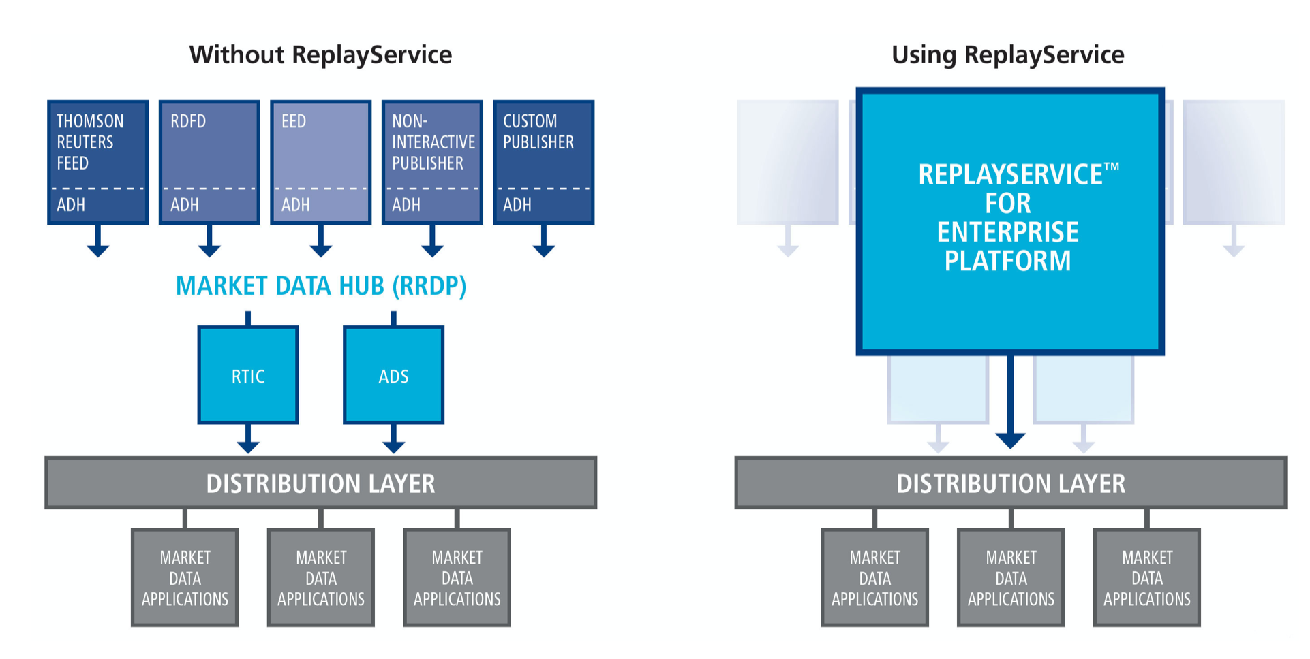
Flaky Tests & External Services
Specialized products replace external components with mocks
Example: TradeWeb ReplayService™: a testing platform for financial market data applications
Originally a product of Thomson Reuters (data provider), then spun off to CodeStreet, then acquired by TradeWeb
https://www.tradeweb.com/our-markets/data--reporting/replay-service/

Slide 35
Flaky Tests Overall
A problem we’re stuck with?
Reduce the scope of a test: small tests aren’t flaky
Remove timed waits, increase timeouts: reduce flaky failures?
Make tests more understandable: can you tell if a failure is flaky or not?
Mitigate with reruns, but this increases test cost
“Software Engineering at Google: Lessons Learned from Programming Over Time,” Wright, Winters and Manshreck, 2020 (O’Reilly)
Notes:
A bigger problem with internal system timeouts is that exceeding them can lead to difficult errors to triage. A production system will often try to limit end-user exposure to catastrophic failure by handling possible internal system issues gracefully. For example, if Google cannot serve an ad in a given time limit, we don’t return a 500, we just don’t serve an ad. But this looks to a test runner as if the ad-serving code might be broken when there is just a flaky timeout issue.

Slide 36
Demo: Writing Tests

Slide 37
Activity: Testing the Transcript Server
https://neu-se.github.io/CS4530-CS5500-Spring-2021/Activities/week5-prof-bell-transcript-server.zip

Slide 38
This work is licensed under a Creative Commons Attribution-ShareAlike license
This work is licensed under the Creative Commons Attribution-ShareAlike 4.0 International License. To view a copy of this license, visit http://creativecommons.org/licenses/by-sa/4.0/
You are free to:
Share — copy and redistribute the material in any medium or format
Adapt — remix, transform, and build upon the material
for any purpose, even commercially.
Under the following terms:
Attribution — You must give appropriate credit, provide a link to the license, and indicate if changes were made. You may do so in any reasonable manner, but not in any way that suggests the licensor endorses you or your use.
ShareAlike — If you remix, transform, or build upon the material, you must distribute your contributions under the same license as the original.
No additional restrictions — You may not apply legal terms or technological measures that legally restrict others from doing anything the license permits.

